Slide 1
Domestic Energy Efficiency Grants – An introduction
Ben Plummer, Colchester City Council

Slide 2
What are the grants for?
Supporting households to make their energy inefficient properties more energy efficient
Majority are fully funded schemes
For a range of measures depending on appropriateness for the home – Mainly insulation (loft, wall, roof, floor) but also can include boiler upgrades, lighting, solar etc. No windows
Notes:
Majority is for supporting low income. Other routes which include health condition routes, Council Tax band routes etc. Discuss later
Survey done to determine what is possible.

Slide 3
Key points
Not a ‘quick fix’ – Process can take several months from referral to install
Not for everyone – But there are other support options out there
It’s complex - But don’t be put off by the complexity - Start with Better Housing, Better Health who can provide the best advice
Notes:
Eligibility can be tight

Slide 4
The grants - overview
Home Upgrade Grant (HUG2) – Off mains gas grid (e.g. electric, oil, LPG) Low incomes/Benefits, Inefficient home.
Energy Company Obligation Phase 4 Flexible Eligibility (ECO4 Flex) – All heating fuel types, Range of routes (inc Health conditions), Inefficient homes
Connected for Warmth – For loft insulation, cavity wall insulation and heating controls. Council Tax Band A-D and inefficient home.
Notes:
March 2025 deadline

Slide 5
HUG2
Eligibility criteria:
  Fuel: Off the mains gas grid (heated by oil, LPG, electric etc)
  EPC: Property has an Energy Performance Certificate (EPC) rating D-G – Check at https://www.gov.uk/find-energy-certificate. If no EPC then still apply if home is cold.
  Income: Household income below £36k/In receipt of benefits
  Owner Occupiers easier. But private renters can apply with landlord permission (only landlords with 4 homes or less)
Fully funded energy efficiency and decarbonisation measures (landlords pay 1/3 of cost)
Recommended if the property is off gas. Houses/bungalows preferred
How to apply: www.hugapply.co.uk or call 0808 196 8255
Notes:
Govt funded
Can get EPC for free.
Can complete referrals on a resident behalf (with permission).

Slide 6
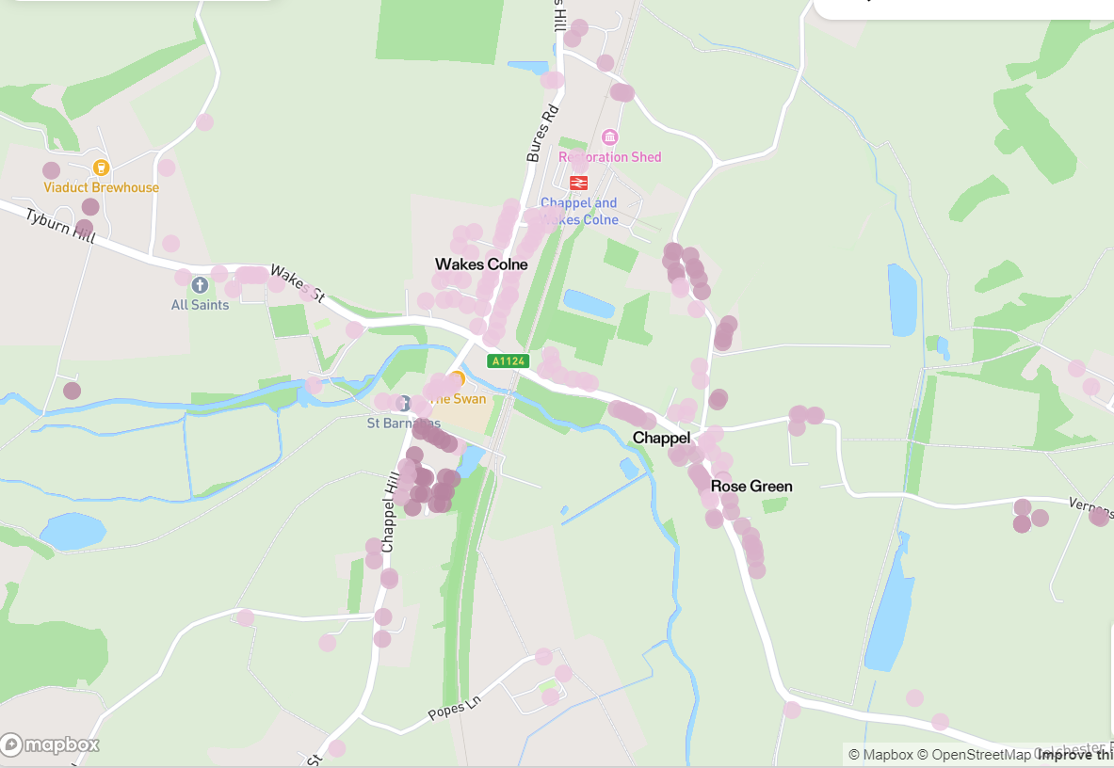
Chappel focus

Slide 7
ECO4
ECO4
Eligibility criteria:
  Fuel: All fuel types
  Many income and other related eligibility routes (e.g. health conditions, vulnerable to cold). Full list on end slide
  Energy Performance Certificate: D-G (E-G preferred to get required increase in energy performance)
Recommended for those on gas grid and low income/benefits/health conditions
Great British Insulation Scheme – For single insulation measures – No income threshold – based on Council tax bands A-D and EPC D-G
How to apply – Online through Better Housing, Better Health https://www.bhbh.org.uk/ or call 0800 107 0044 – They’ll determine best grant or other supports for resident
Notes:
BHBH have access to other grants for small measure grants, boiler replacements etc
Can complete referrals on a resident behalf (with permission).

Slide 8
Connected for Warmth
Eligibility criteria:
  Fuel: All fuel types
  EPC: Property has an Energy Performance Certificate rating C-G – Check at https://www.gov.uk/find-energy-certificate. If no EPC then still apply if home is cold.
  Income: No income threshold. Home just needs to be in Council tax band between A-D – Check at https://www.gov.uk/council-tax-bands
Only for loft insulation, cavity wall insulation or heating controls
Can call BHBH or apply directly to Connected for Warmth if you want specific insulation or if you know you aren’t eligible for ECO4 - https://www.connectedforwarmth.org.uk/, 0800 107 8576

Slide 9
Other support
BHBH is great for general advice and also offer support like fuel vouchers, small measure grants (for thermal curtains, blankets etc).
Green Doctor – Energy Switching support, understanding bills etc – Can offer in-person support.
Community Energy Colchester – Offer in person visits, free radiator reflective panels.

Slide 10
Contact information
Best place to start is with BHBH - https://www.bhbh.org.uk/ or call 0800 107 0044
For general enquiries, issues with application process etc – EnergyEfficientHomes@colchester.gov.uk
For communication materials – EnergyEfficientHomes@colchester.gov.uk
CCC Website – www.colchester.gov.uk/energy-grants
Green Doctor - To apply visit https://groundwork.my.salesforce-sites.com/CadentEnquiryForm or call 07702941440
Community Energy Colchester – To enquire about the support, email - Chris@communityenergycolchester.com or call 07799494797

Slide 11
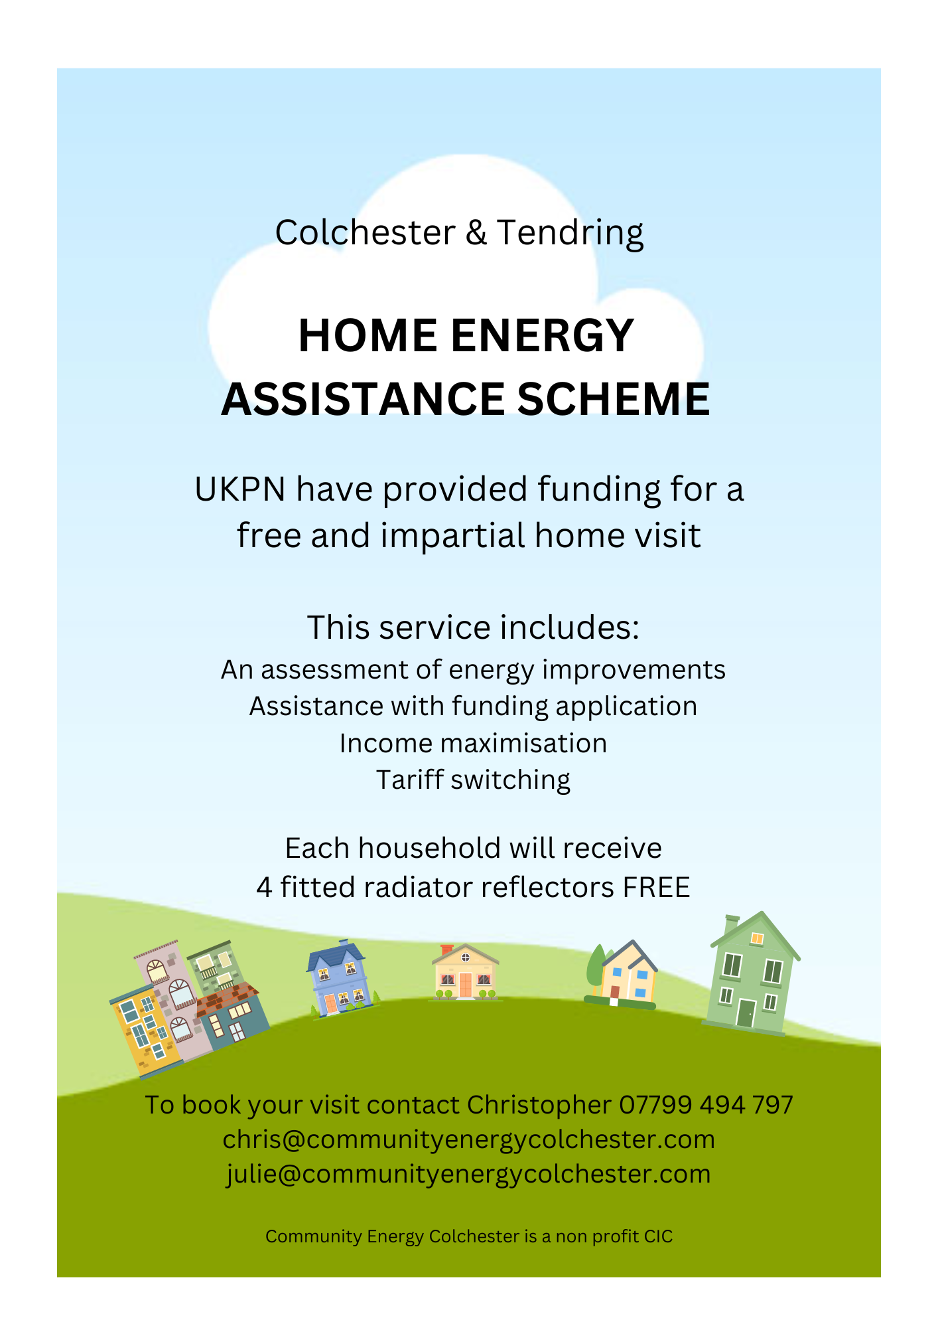
Community Energy Colchester poster

Slide 12
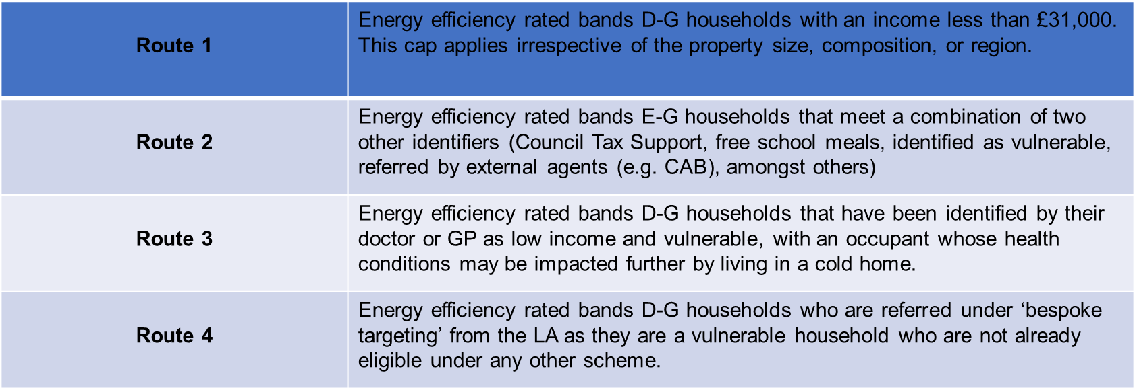
ECO4 routes
Full list available here
Notes:
NOT FOR PRESENTING

